Slide 1

Facial Emotion Prediction using Deep Learning Algorithms
Presented by- Ramsetty Nirosha
CWID-50333708

Slide 2
About Our Research work : Predicting Emotions from facial expressions
Why this research
is important
It is important to achieve a cutting-edge machine or software which makes it possible for various applications like healthcare, human and machine interaction, identification of human emotion and further reacting to it accordingly.
The problem statement of this research is how could deep learning methods be enhanced to recognize human emotions and understand those emotions more accurately and robustly in a variety of environmental settings and population groups which has various applications in the field of health monitoring, security and surveillance, human-computer interactions, gaming, customer feedbacks, etc.
Problem Statement
The purpose of this research work is to establish a powerful, precise and intelligent system which can easily and automatically detect facial features and recognize the emotions of humans using deep learning techniques.
Aim & Objective
Our hypothesis depicts that developing an effective emotion detection system involves training a deep learning model with a diverse dataset of facial expressions, employing techniques like data augmentation and noise reduction. Utilizing recurrent neural network models like LSTM and DNN aids in handling sequential data. The model, optimized with algorithms such as Adam and RMSprop, classifies images into seven emotion classes, predicting the probability of each class for accurate emotion detection.
Our Hypothesis

Slide 3
Methodology Overview: Machine Learning Approach for Facial emotion Prediction
For the facial emotion recognition system, the image dataset must be of high quality and precise which has a diverse collection of facial expressions ranging from all ages, genders, and types which is very beneficial for the predictive model to train on a diverse range of emotions like anger, disgust, fear, neutral, surprise, happy, sad.
Data Collection:
Data
Augmentation & processing:
It involves rigorous steps like noise removal, normalization, and scaling, ensuring data stability and significance for facial emotion recognition while splitting data into training, validation, and testing sets optimizes model accuracy and performance.
Deep learning models like CNN, LSTM and DNN are utilized at analyzing dynamic facial expressions over time. Optimized with algorithms like the Adam Optimizer, these models effectively capture minute details, ensuring precise emotion prediction while remaining adaptable in their learning process.
Model Training:
Evaluation Methods:
Assessed the performance of the models using the training and validation loss and accuracy of the running model for some epochs.

Slide 4
Enhancing Model Performance Through data augmentation , Processing and Hyperparameter Tuning
Data Augmentation:
enhances deep learning models in facial emotion recognition by diversifying training data through alterations like zooming, rotation, and brightness adjustment.
mitigates underfitting issues, leading to improved accuracy and consistency, particularly with expanded datasets.
Data Processing & Model Training :
Splitting data into training, validation, and testing sets optimizes model accuracy and performance, with training data building model accuracy, validation data fine-tuning hyperparameters, and testing data assessing real-world accuracy.
Hyperparameter Tuning:
The Adam optimizer known for its adaptability and low memory usage enhances model accuracy and reduces loss functions in deep learning.
Often paired with techniques like RMSprop and Gradient Descent, it improves efficiency, performance, and robustness across various models in facial emotion recognition research.

Slide 5
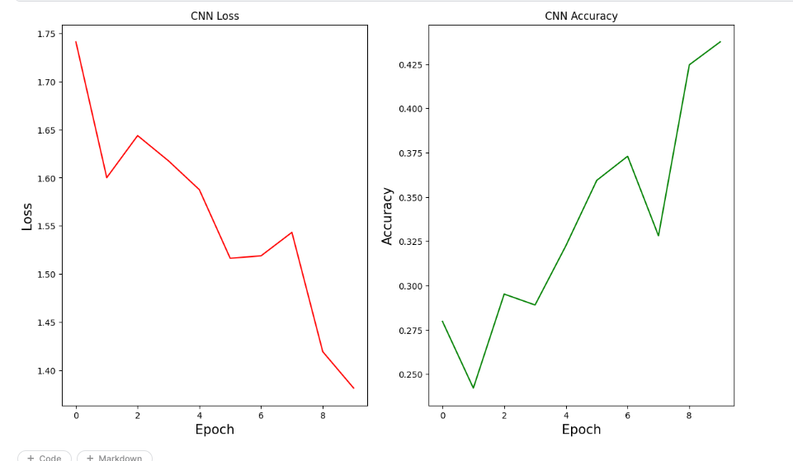
Performance evaluation and Graph of the cnn model
Convolutional Neural
Network (CNN) :
Accuracy : 0.437
Loss : 1.3813
Graph & Running Model:
After 10 epochs, the CNN model achieves an accuracy of 43.7%. The plotted line graph illustrates a decreasing trend in the loss value and an increasing trend in accuracy with each epoch, indicating the model's improving performance over time.

Slide 6
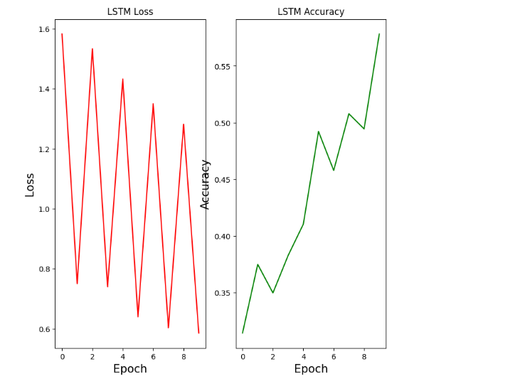
Performance evaluation and Graph of the lstm model
Long short-term Memory
(LSTM) :
Accuracy : 0.578
Loss : 0.5887
Graph & Running Model:
The LSTM model achieves an accuracy of 57.8%, outperforming the CNN model. The line graph displays a decreasing trend in loss value and an increasing trend in accuracy with each epoch, showing the model's effective performance and consistent improvement.

Slide 7
Performance evaluation and Graph of dnn model
Deep Neural Network
(DNN) :
Accuracy : 0.2422
Loss : 0.6060
Graph & Running Model:
The accuracy of the DNN Model is 0.242 which is poor as compared to other models utilized before. The line graph shown below displays the fluctuation of Loss and Accuracy of the Deep Neural Network model.

Slide 8
Results
Research Objective: Precisely predict human emotions based on diverse facial features and expressions in the dataset.
Dataset Description: Contains seven different types of human emotions for studying facial patterns and attributes.
Methodology: Utilized deep learning and neural network techniques, including CNN, RNN (specifically LSTM), and DNN models.
Model Comparison: LSTM model outperformed others with the highest accuracy score of 0.578, while DNN model showed weaker performance with an accuracy of 0.242.
Training Process: Models were trained, tested, and validated using provided datasets, with LSTM showing optimal results after 10 epochs.
Integration of Optimizer: Adam optimizer was integrated to further enhance model performance and prediction rate.

Slide 9
CONCLUSION :
Emphasis on Deep Learning: Highlights the utility of deep learning techniques for leveraging facial expression data effectively.
Custom Model Development: Custom CNN and RNN models were specifically built for the dataset to accurately represent various human emotions.
Optimization for Efficiency: Models were optimized to achieve faster predictions without compromising accuracy, reducing parameters and procedures.
Hybrid Deep Learning Approach: Introduces an innovative method combining CNN, LSTM, and DNN models for facial expression identification.
CNN Architecture: Utilizes two convolutional layers, two pooling layers, and two fully-connected layers in the suggested CNN technique.
Experimental Results: Showcases improved performance in reliably identifying facial expressions, with the LSTM model demonstrating optimal performance compared to other models.
Importance of Facial Expression Components: By exploiting key components of facial expressions, recognition accuracy and effectiveness can be enhanced.

Slide 10
Future Work:
Conduct | Improving data augmentation techniques can improve model robustness and adaptation across various contexts and populations by increasing the wide range and authenticity of training datasets.
Investigate | Combining multiple data like speech and body language may provide a more in-depth understanding of emotional states and result in emotion identification systems that are more realistic.
Collaborate
This research has enormous potential to change human-computer interactions and improve society at large through collaborative research and continuous innovation.

Slide 11
Thank You

